Slide 1
Maximum Flow
Maximum Flow Problem
The Ford-Fulkerson method
Maximum bipartite matching

Slide 2
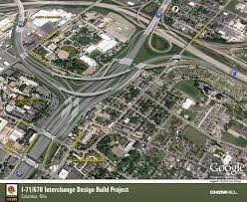
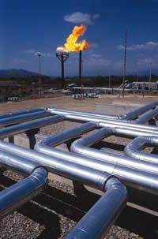



Slide 3
Flow networks:
A flow network G=(V,E): a directed graph, where each edge (u,v)∈E has a nonnegative capacity c(u,v)>=0.
If (u,v)∉E, we assume that c(u,v)=0.
two distinct nodes: a source s and a sink t.
SOURCE:
Node with net outflow:
Production point
SINK:
Node with net inflow;
Consumption point
12
16
20
s
10
9
7
t
CAPACITY:
Maximum flow
on an edge
4
13
4
14

Slide 4
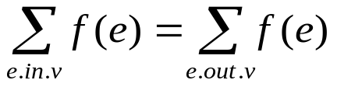
Flow:
Given: G=(V, E): a flow network with capacity function c.
s---the source and t--- the sink.
A flow in G: a real-valued function f: E →R satisfying the following two properties:
Capacity constraint: For all u,v ∈V, we require
f(u,v) ≤ c( u,v).
Flow conservation: For all v ∈V-{s,t}, we require

Slide 5
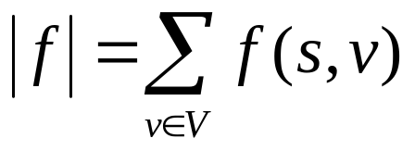
Net flow and value of a flow f:
The quantity f (u,v) is called the net flow from vertex u to vertex v.
The value of a flow is defined as
  The total flow from the source (s) to any other vertices.
  The same as the total flow from any vertices to the sink (t).

Slide 6
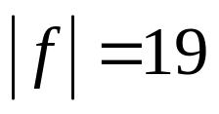
Net flow
capacity
12/12
11/16
15/20
s
10
t
1/4
4/9
7/7
8/13
4/4
11/14
A flow f in G with value .

Slide 7

Maximum-flow problem:
Given a flow network G with source s and sink t
Find a flow of maximum value from s to t.
How to solve it efficiently?

Slide 8
The Ford-Fulkerson method:
Ford-Fulkerson method
  it is a “method” rather than an “algorithm” because it encompasses several implementations with different running times.
  The Ford-Fulkerson method depends on three important ideas:
    residual networks
    augmenting paths, and
    cuts.

Slide 9
Continue:
FORD-FULKERSON-METHOD(G,s,t)
initialize flow f to 0
while there exists an augmenting path p
do augment flow f along p
return f

Slide 10
12
v₁
v₃
16
20
s
10
4
7
t
9
13
4
v₂
v₄
14

Slide 11
Example
4/12
12
v₁
v₃
4/16
v₁
v₃
20
16
20
s
7
s
10
4
7
t
10
4
t
4/9
9
13
13
4/4
v₂
v₄
4
v₂
v₄
4/14
14
(a)
Bold path: augment path
Net flow
Flow
8
12
v₁
v₃
20
4
s
4
4
10
4
t
7
5
13
10
4
v₂
v₄
Residual network
4

Slide 12
8
4/12
12
v₁
v₃
v₁
v₃
20
4/16
20
4
s
4
4
s
10
4
t
10
4
7
t
7
4/9
5
13
10
4
13
4/4
v₂
v₄
v₂
v₄
4
4/14
8
4/12
12
v₁
v₃
20
11/16
v₁
v₃
7/20
4
s
4
4
10
4
t
s
7/10
7/7
t
7
4
4/9
5
13
10
4
13
4/4
v₂
v₄
v₂
v₄
4
11/14

Slide 13
4/12
11/16
v₁
v₃
7/20
s
7/10
4
7/7
t
4/9
13
4/4
v₂
v₄
Net flow network
11/14
8
5
v₁
v₃
4
13
11
s
4
7
3
11
t
5
7
13
3
4
v₂
v₄
11
(b)
Residual network

Slide 14
Residual networks:
Given a flow network and a flow, the residual network consists of edges that can admit more net flow.
f: a flow in G.
The residual capacity of (u,v), given by:
  c_{f}(u,v) =c(u,v)-f(u,v)
  in the other direction
  c_{f}(v,u) =c(v, u)+f(u, v).

Slide 15
Fact 1:
Let G=(V,E) be a flow network with source s and sink t, and let f be a flow in G.
Let G_{f} be the residual network of G induced by f, and let f’ be a flow in G_{f}. Then, the flow sum f+f’ is a flow in G with value .
f+f’: the flow in the same direction will be added.
the flow in different directions will be cancelled.

Slide 16
Augment paths:
Given a flow network G=(V,E) and a flow f, an augment path is a simple path from s to t in the residual network G_{f}.
Residual capacity of p : the maximum amount of net flow that we can ship along p, i.e.,
c_{f}(p)=min{c_{f}(u,v):(u,v) is on p}.
2
3
1
The residual capacity is 1.

Slide 17
Cut and flow

Slide 18
12
v₁
v₃
12
16
20
v₁
v₃
16
20
s
10
4
7
t
9
s
10
4
7
t
9
13
4
v₂
v₄
13
4
v₂
v₄
14
14
|f| ≤ 12+7+4,
|f| ≤ 12+14,
Theorem max |f|=min |cut|

Slide 19

The basic Ford-Fulkerson algorithm:
FORD-FULKERSON(G,s,t)
for each edge (u,v) ∈E[G]
do f[u,v] 0
f[v,u] 0
while there exists a path p from s to t in the residual network G_{f}
do c_{f}(p) min{c_{f}(u,v): (u,v) is in p}
for each edge (u,v) in p
do f[u,v] f[u,v]+c_{f}(p)

Slide 20
The basic Ford Fulkerson algorithm example of an execution
Network
12
v1
v3
16
20
4
7
10
S
9
t
4
13
v2
v4
14

Slide 21
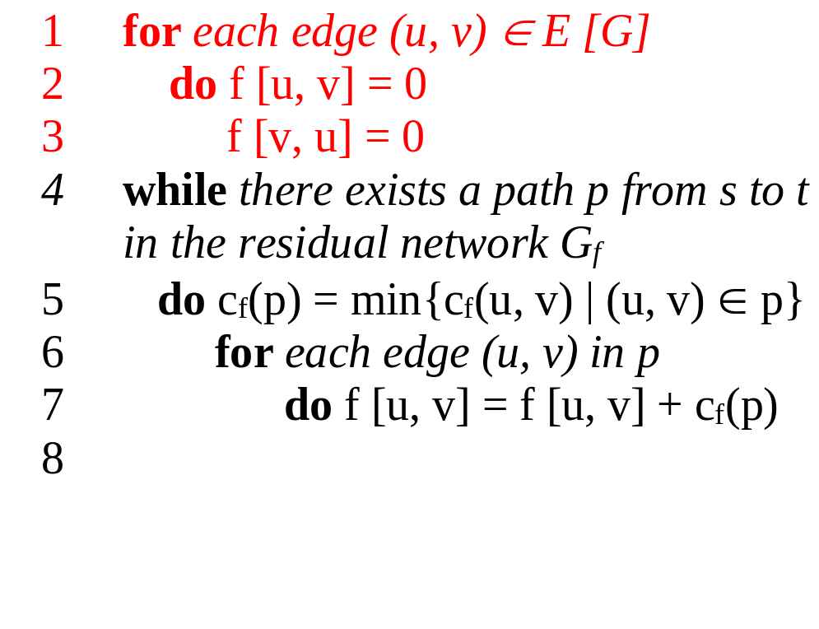
The basic Ford Fulkerson algorithm example of an execution
0/12
v1
v3
0/16
0/20
0/4
0/7
0/10
S
0/9
t
0/4
0/13
v2
v4
0/14

Slide 22
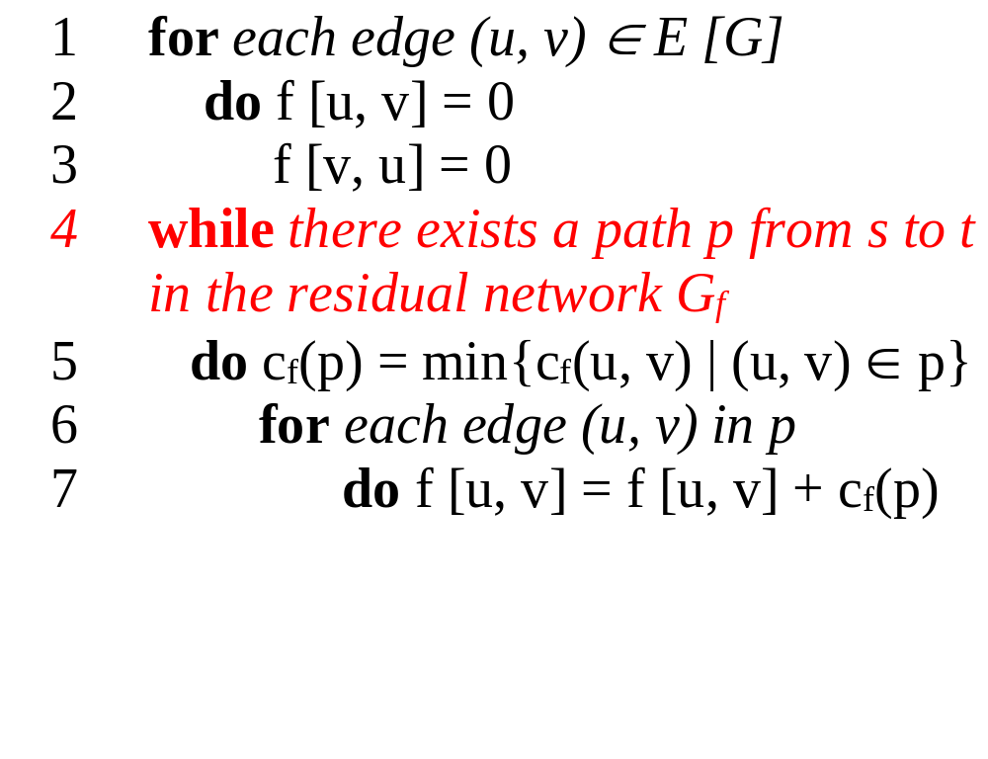
The basic Ford Fulkerson algorithm example of an execution
v1
12
v3
16
20
10
4
7
S
9
t
4
13
v2
v4
14

Slide 23
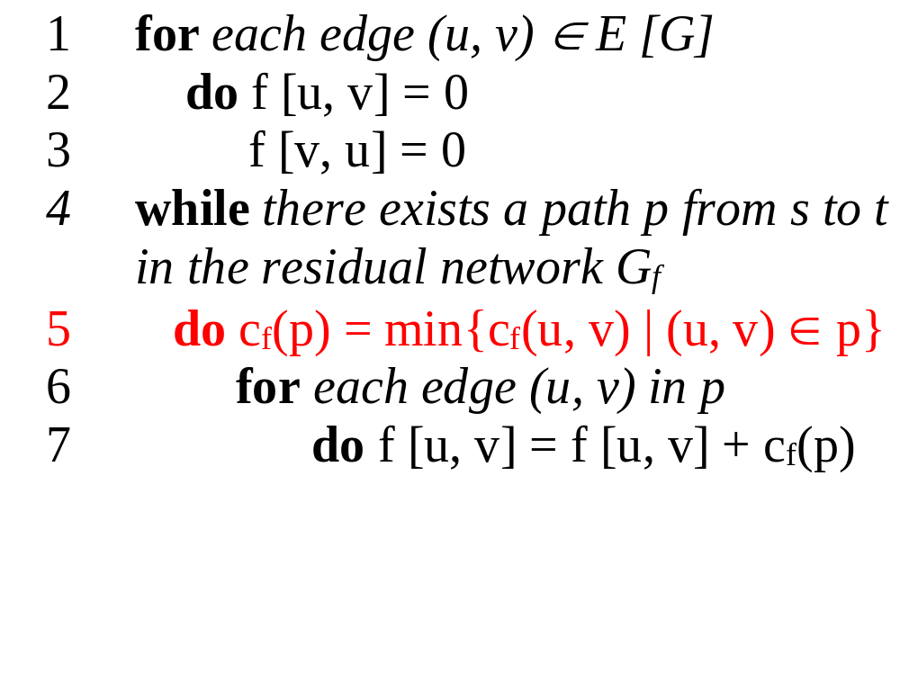
The basic Ford Fulkerson algorithm example of an execution
(residual) network G_{f}
v1
12
v3
16
20
10
4
7
S
9
t
4
13
v2
v4
14
temporary variable:
c_{f} (p) = 12

Slide 24
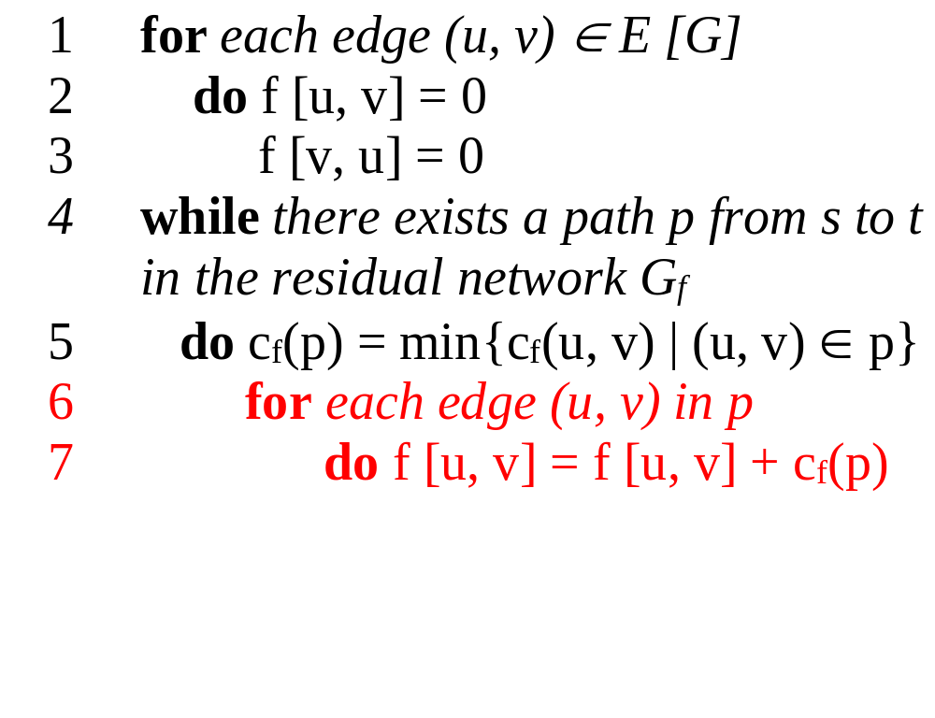
The basic Ford Fulkerson algorithm example of an execution
(residual) network G_{f}
v1
12
v3
16
20
10
4
7
S
9
t
4
13
v2
v4
14
new flow network G
12/12
v1
v3
12/16
temporary variable:
c_{f} (p) = 12
12/20
10
4
7
S
9
t
4
13
v2
v4
14

Slide 25
The basic Ford Fulkerson algorithm example of an execution
(residual) network G_{f}
v1
12
v3
4
8
12
10
4
7
12
S
9
t
4
13
v2
v4
14
new flow network G
12/12
v1
v3
12/16
12/20
10
4
7
S
9
t
4
13
v2
v4
14

Slide 26
The basic Ford Fulkerson algorithm example of an execution
(residual) network G_{f}
v1
12
v3
4
8
12
10
4
7
12
S
9
t
4
13
v2
v4
14
new flow network G
12/12
v3
v1
12/16
12/20
10
4
7
S
9
t
4
13
v2
v4
14

Slide 27
The basic Ford Fulkerson algorithm example of an execution
(residual) network G_{f}
v1
12
v3
4
8
12
10
4
7
12
S
9
t
4
13
v2
v4
14
new flow network G
12/12
v1
v3
12/16
12/20
10
4
7
S
9
t
4
13
v2
v4
14

Slide 28
The basic Ford Fulkerson algorithm example of an execution
(residual) network G_{f}
v1
12
v3
4
8
12
10
4
7
12
S
9
t
4
13
v2
v4
14
new flow network G
12/12
v1
v3
12/16
12/20
10
4
7
S
9
t
temporary variable:
c_{f} (p) = 4
4
13
v2
v4
14

Slide 29
The basic Ford Fulkerson algorithm example of an execution
(residual) network G_{f}
v1
12
v3
4
8
12
10
4
7
12
S
9
t
4
13
v2
v4
14
new flow network G
12/12
v1
v3
12/16
12/20
temporary variable:
c_{f} (p) = 4
10
4
7
S
9
t
4/4
4/13
v2
v4
4/14

Slide 30
The basic Ford Fulkerson algorithm example of an execution
(residual) network G_{f}
v1
12
v3
4
8
12
10
4
7
12
S
9
t
4
4
4
9
v2
v4
10
new flow network G
12/12
v1
v3
12/16
12/20
10
4
7
S
9
t
4/4
4/13
v2
v4
4/14

Slide 31
The basic Ford Fulkerson algorithm example of an execution
(residual) network G_{f}
v1
12
v3
4
8
12
10
4
7
12
S
9
t
4
4
4
9
v2
v4
10
new flow network G
12/12
v1
v3
12/16
10
4
7
12/20
S
9
t
4/4
4/13
v2
v4
4/14

Slide 32
The basic Ford Fulkerson algorithm example of an execution
(residual) network G_{f}
v1
12
v3
4
8
12
10
4
7
12
S
9
t
4
4
4
9
v2
v4
10
new flow network G
12/12
v1
v3
12/16
12/20
10
4
7
S
9
t
4/13
4/4
v2
v4
4/14

Slide 33
The basic Ford Fulkerson algorithm example of an execution
(residual) network G_{f}
v1
12
v3
4
8
12
10
4
7
12
S
9
t
4
4
4
9
v2
v4
10
new flow network G
12/12
v1
v3
12/16
12/20
temporary variable:
c_{f} (p) = 7
10
4
7
S
9
t
4/4
4/13
v2
v4
4/14

Slide 34
The basic Ford Fulkerson algorithm example of an execution
(residual) network G_{f}
v1
12
v3
4
8
12
10
4
7
12
S
9
t
4
4
4
9
v2
v4
10
new flow network G
12/12
v1
v3
12/16
19/20
temporary variable:
c_{f} (p) = 7
10
4
7/7
S
9
t
4/4
11/13
v2
v4
11/14

Slide 35
The basic Ford Fulkerson algorithm example of an execution
(residual) network G_{f}
v1
12
v3
4
1
12
10
4
7
19
S
9
t
11
11
4
2
v2
v4
3
new flow network G
12/12
v1
v3
12/16
19/20
10
4
7/7
S
9
t
11/13
4/4
v2
v4
11/14

Slide 36
The basic Ford Fulkerson algorithm example of an execution
(residual) network G_{f}
v1
12
v3
4
1
12
10
4
7
19
S
9
t
11
11
4
2
v2
v4
3
new flow network G
12/12
v1
v3
12/16
19/20
10
4
7/7
Finally we have:
| f | = f (s, V) = 23
S
9
t
11/13
4/4
v2
v4
11/14

Slide 37
Time complexity:
If each c(e) is an integer, then time complexity is O(|E|f*), where f* is the maximum flow.
Reason: each time the flow is increased by at least one.
This might not be a polynomial time algorithm since f* can be represented by log (f*) bits. So, the input size might be log(f*).

Slide 38
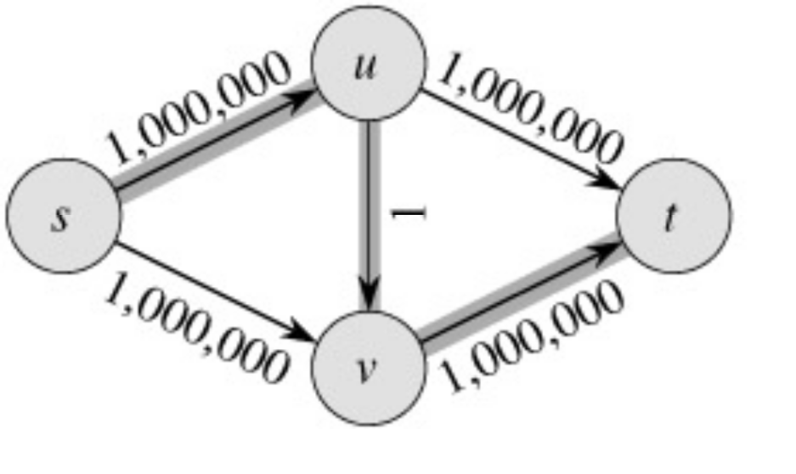
The Basic Ford-Fulkerson Algorithm
With time O ( E |f*|), the algorithm is not polynomial.
Ford-Fulkerson may perform very badly unlucky:
|f*|=2,000,000
CSE 3101

Slide 39
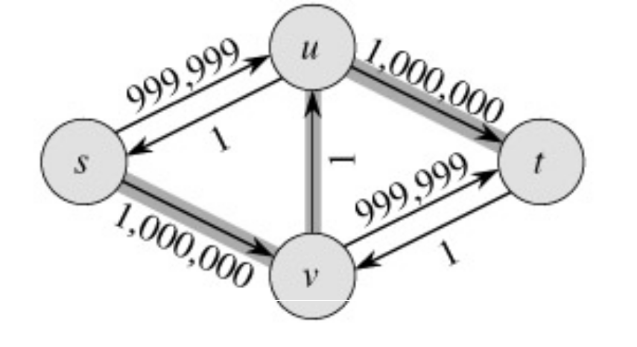
Run Ford-Fulkerson on this example
Augmenting Path
Residual Network
CSE 3101

Slide 40
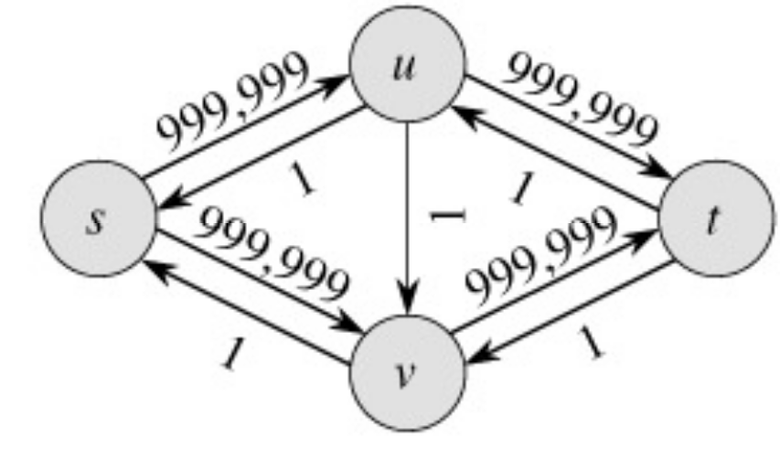
Augmenting Path
Residual Network
CSE 3101

Slide 41

Repeat 999,999 more times…
Can we do better than this?
CSE 3101

Slide 42
The Edmonds-Karp algorithm
Find the augment path using breadth-first search.
Breadth-first search gives the shortest path for graphs (Assuming the length of each edge is 1.)
Time complexity of Edmonds-Karp algorithm is O(V*E²).
The proof is very hard and is not required here.
breadth first search link:
https://en.wikipedia.org/wiki/Breadth-first_search

Slide 43
Breadth-first search
12
v₁
v₃
16
20
s
10
4
7
t
9
13
4
v₂
v₄
14
Path : s->v1->v3->t Path: s->v2->v4->t.
(a)

Slide 44
Example :
a
100
100
s
t
1
100
100
b
Applying breadth first search
a
100
100
s
t
100
100
b

Slide 45
Residual graph
a
100/100
100/100
s
t
0/1
0/100
0/100
b
Again Run BFS So the obvious path is s-b-t
a
100/100
100/100
s
t
0/1
100/100
100/100
b

Slide 46
Maximum bipartite matching

Slide 47
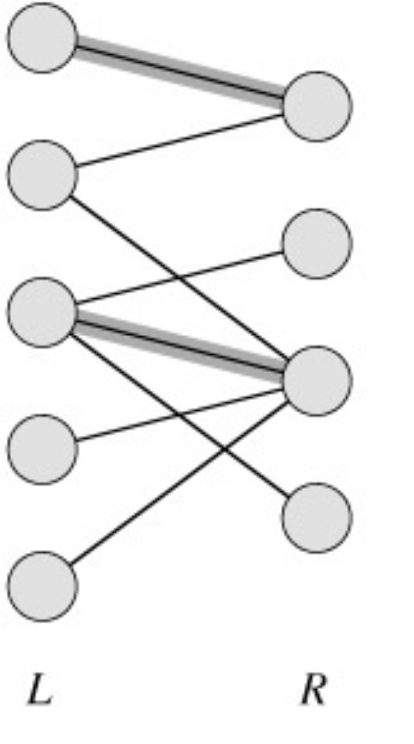
Maximum Bipartite Matching
A bipartite graph is a graph G=(V,E) in which V can be divided into two parts L and R such that every edge in E is between a vertex in L and a vertex in R.
e.g. vertices in L represent skilled workers and vertices in R represent jobs. An edge connects workers to jobs they can perform.

Slide 48
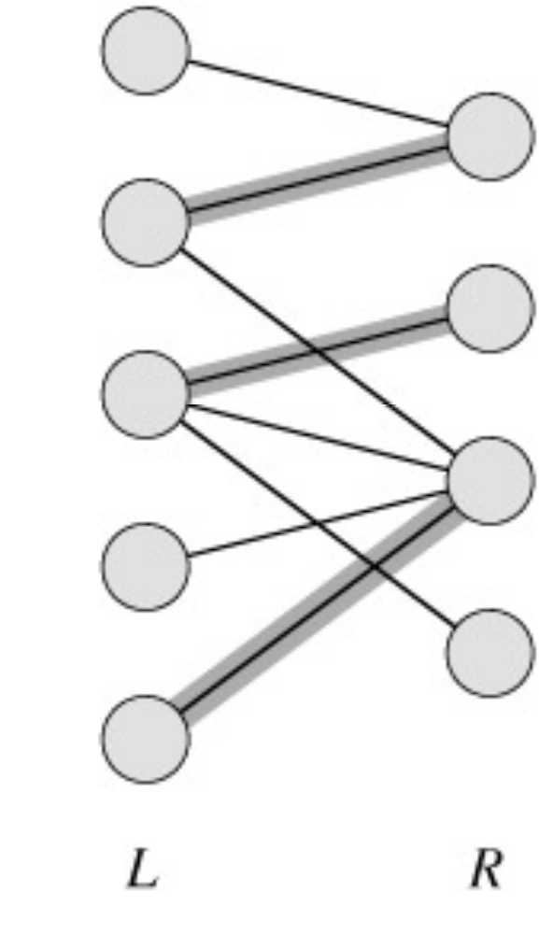
A matching in a graph is a subset M of E, such that for all vertices v in V, at most one edge of M is incident on v.

Slide 49
A maximum matching is a matching of maximum cardinality (maximum number of edges).
not maximum
maximum

Slide 50
A Maximum Matching
No matching of cardinality 4, because only one of v and u can be matched.
In the workers-jobs example a max-matching provides work for as many people as possible.
v
u

Slide 51
Solving the Maximum Bipartite Matching Problem
Reduce the maximum bipartite matching problem on graph G to the max-flow problem on a corresponding flow network G’.
Solve using Ford-Fulkerson method.

Slide 52
Corresponding Flow Network
To form the corresponding flow network G' of the bipartite graph G:
  Add a source vertex s and edges from s to L.
  Direct the edges in E from L to R.
  Add a sink vertex t and edges from R to t.
  Assign a capacity of 1 to all edges.
Claim: max-flow in G’ corresponds to a max-bipartite-matching on G.
G
→G’
1
1
1
1
1
1
1
1
1
s
1
1
t
1
1
1
1
L
R

Slide 53
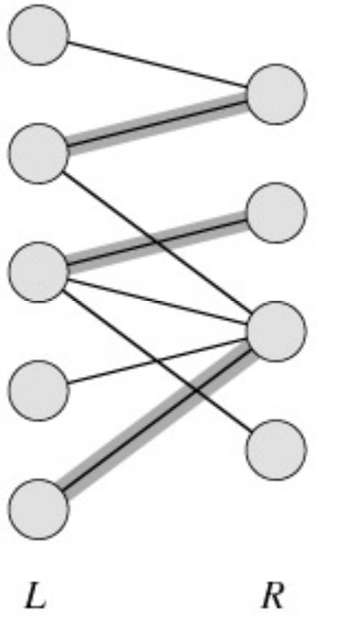
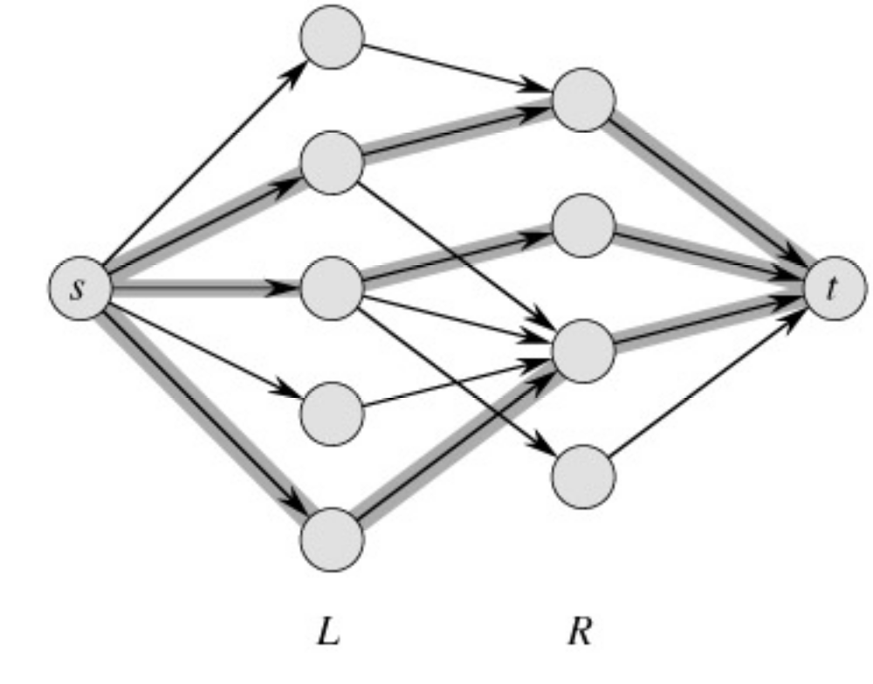
Example
|M| = 3 ←→ max flow =|f|= 3

